Slide 1

SOCIAL ENGINEERING TOOLKIT DEMONSTRATION & UNSECURED WEBSITE OVERVIEW
Keya Upadhyay
Maggie Kozlowski
Anita Sanap
Rupinder Kaur

Slide 2
Overview
Generated an unsecure website http://rainbowcrib.com
Utilizing Social Engineering Toolkit to perform Mass Mailer Attack, Credential Harvesting Attack and Reverse TCP Exploit using the website URL
How to analyse a phishing email
Mitigation steps

Slide 3
Tools utilized
Kali Linux
Social Engineering Toolkit (SET)
WordPress
Metasploit
2MHOST/GoDaddy

Slide 4
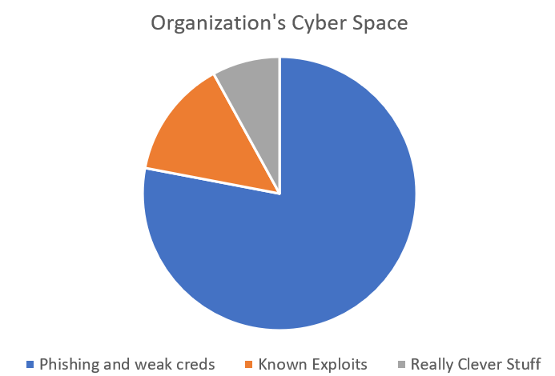
Phishing Attacks in Cyberspace
At 16%, phishing stands as a prominent attack vector in the realm of cybercrime.
Half of the phishing websites employed SSL certificates.
Approximately 3.4 billion phishing emails are sent each day.
Roughly 88% of companies experience annual phishing attacks, indicating near-daily targeting of businesses.
Notes:
references:
https://www.getastra.com/blog/security-audit/phishing-attack-statistics/

Slide 5
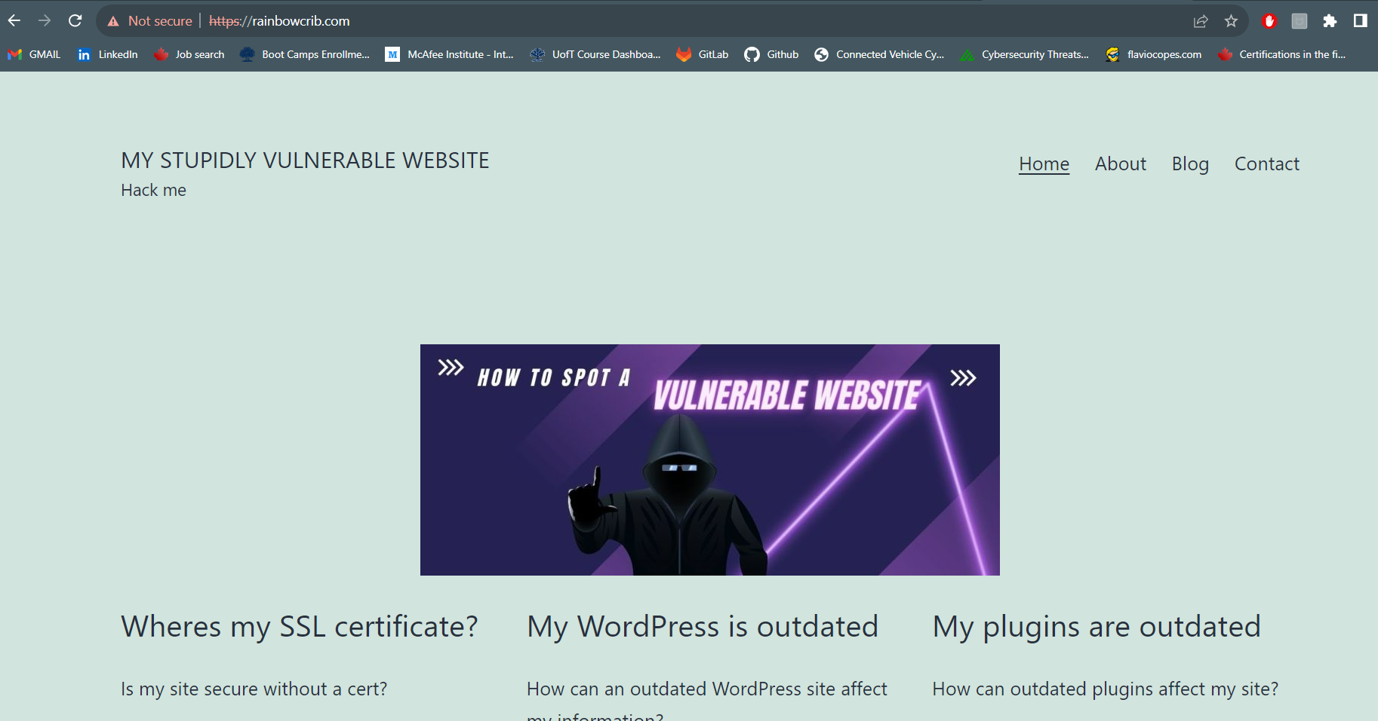
Our Web-application “http://rainbowcrib.com”

Slide 6
Social Engineering Toolkit (Kali Linux)
Open Source Pentesting Framework
Designed to help security Professionals / Pentester to simulate Social Engineering Attack
Used by Bad Actors to gain unauthorised information
Provides range of Tools and attack vectors for conducting simulated social engineering attacks
Notes:
Reference: (ChatGPT)

Slide 7
Mass Mailer Attack
Key Points
Mass mailer attack is used to send the phishing page link to the email addresses of the purpose
Phishing emails contains Malicious link, Malware attachment or Scam.
User Access Malicious link or attachment.
User exploited by phishing email and leak sensitive information.
Notes:
Reference: Artykov, D. (2021, May 16). Mass mailer attack using Social Engineering Toolkit. Purple TEAM. https://medium.com/purple-team/mass-mailer-attack-using-social-engineering-toolkit-4320dcdc2d31

Slide 8
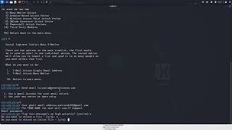
Mass Mailer Attack

Slide 9
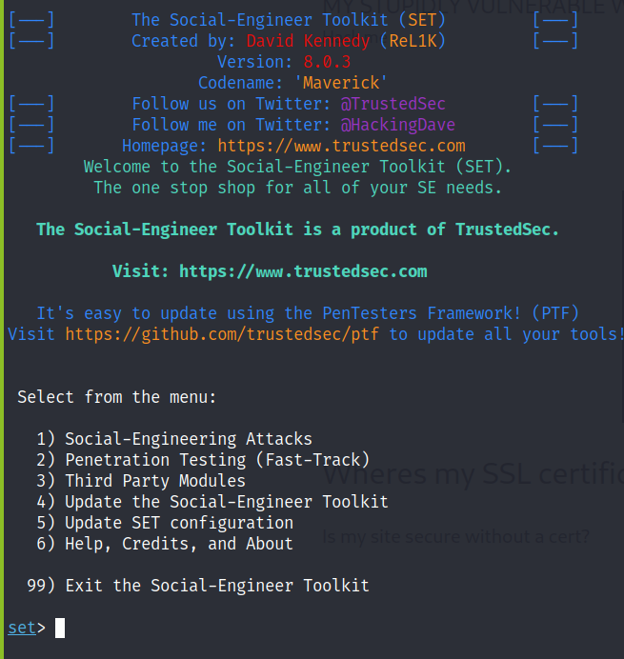
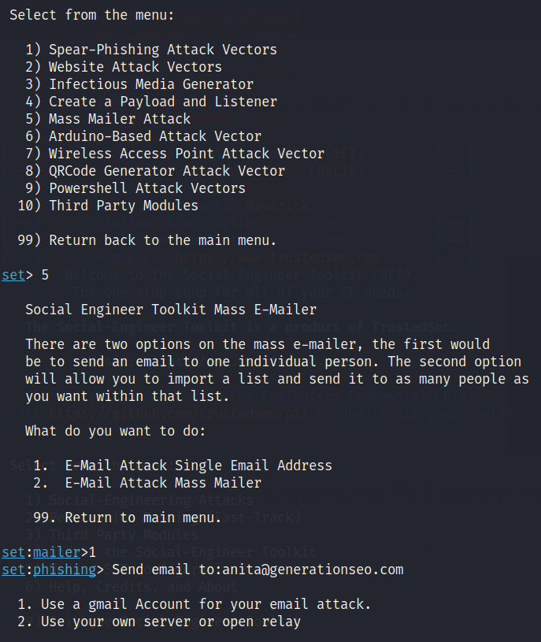
Mass Mailer Attack

Slide 10
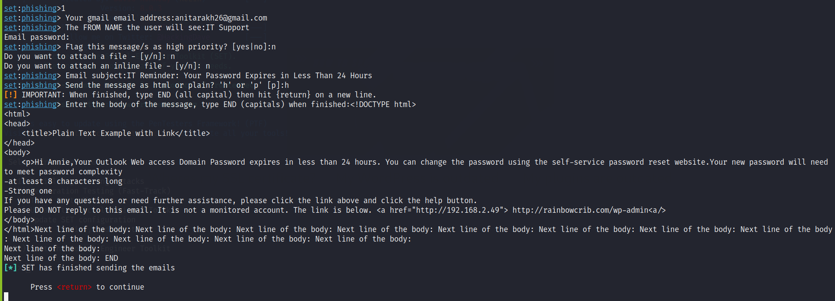
Mass Mailer Attack

Slide 11
Credentials Harvesting Attack
Key Points
Threat actors perform credential harvesting attack to collect usernames and passwords
Then they often use these to penetrate networks. or sell them for money
Most of the times; employees reuse credentials on other websites, applications and systems. For cyber criminals it gets easy to attack other networks
Once access is gained, attackers can easily bounce from database access to sensitive data
Notes:
Reference: mimecast. (2022, August 25). What Is Credential Harvesting? Mimecast. https://www.mimecast.com/blog/what-is-credential-harvesting/

Slide 12
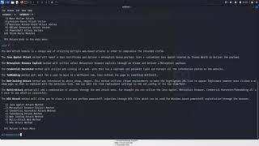
Credentials Harvesting Attack

Slide 13
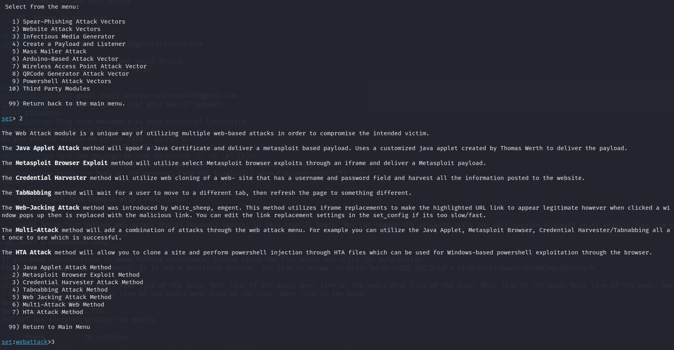
Website attack Vectors
Used Website attack Vectors from Kali Social Engineering Toolkit.

Slide 14
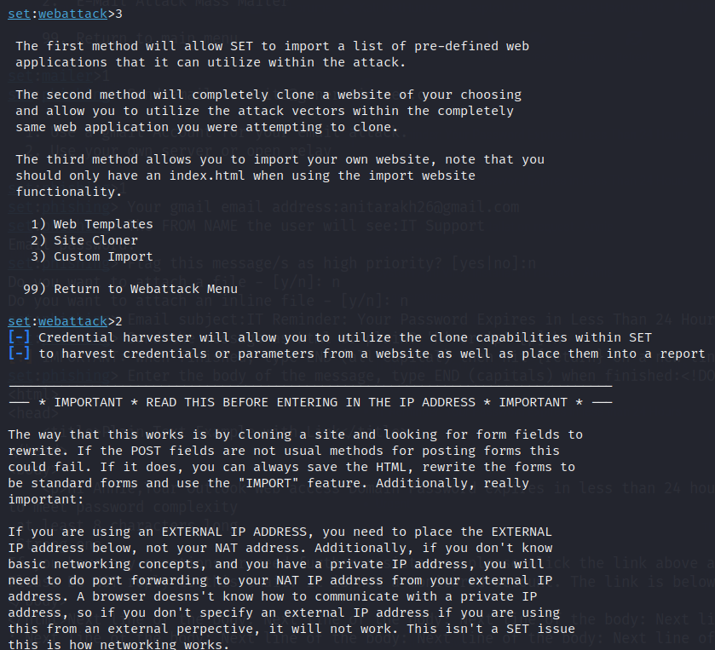
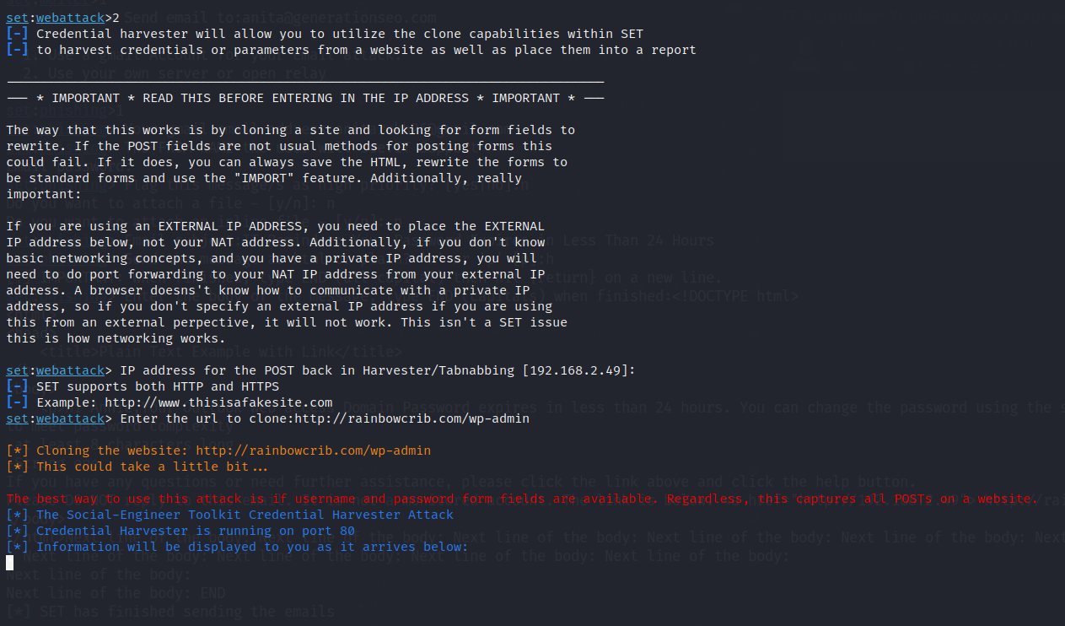
Credential Harvester Attack Method
Used hacker’s machine IP address as hacker will be getting results on their machine and website URL which are to be cloned.
Selected Site clone from the options.

Slide 15
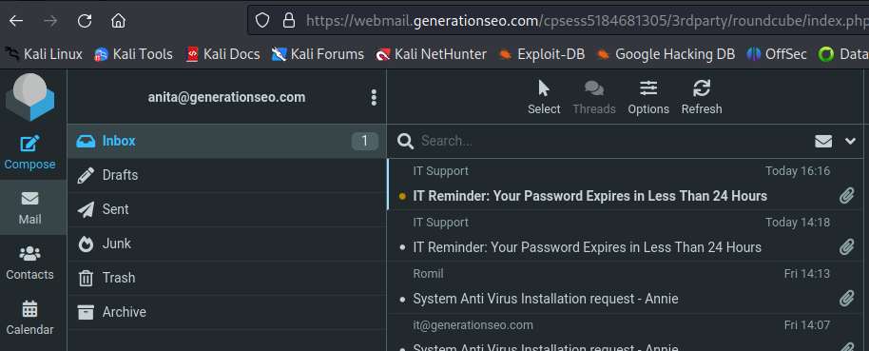
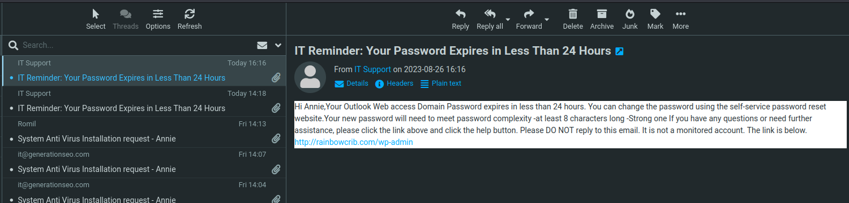
Successful!
As shown, victim received the intended email
Email content

Slide 16
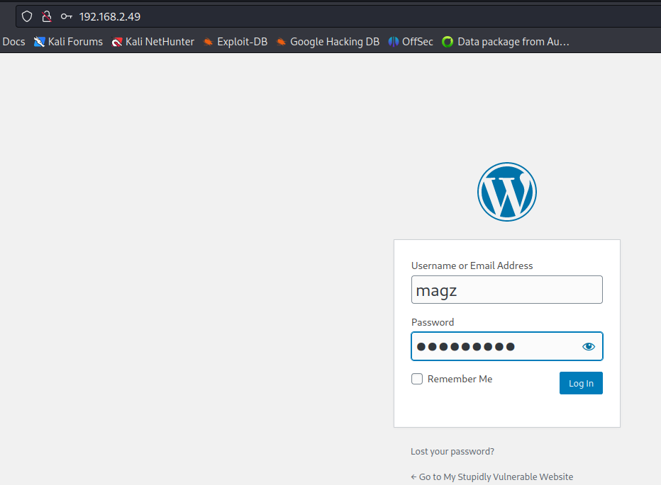
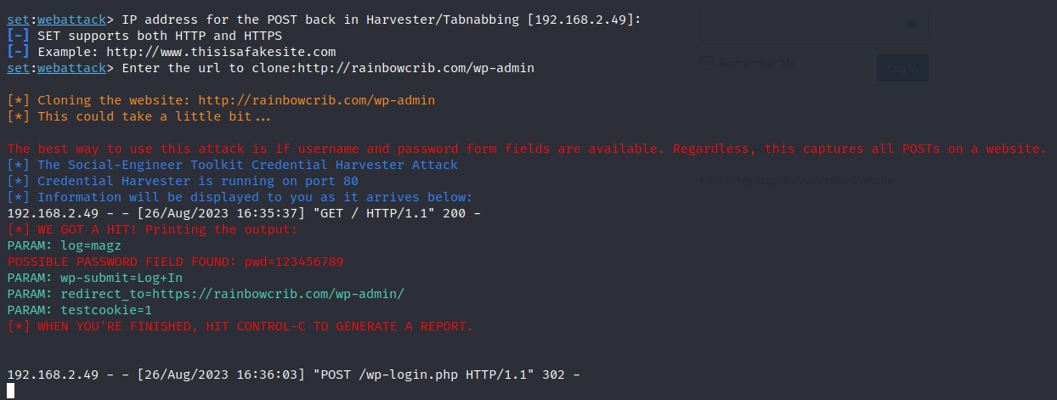
Credential Harvester Attack Method
The hacker machine’s IP showing as URL but the site content looks like original site.
Hacker’s terminal showing the user’s username/password as expected.

Slide 17
SET: Creating Payload and Listener
KEY POINTS
1. Hacker Preferred Method - Delivered via phishing emails or malicious websites embedded within a software installation or a document
2. Allow attackers to bypass network security mechanisms like firewalls and other detection systems
3. Opens a shell connection from Victim’s server to the Attacker, hence, called Reverse TCP Attack
4. Remote Control Persistent access can be gained without requiring to deploy another malicious payload and able to run the system as wished.
Notes:
Reference:https://hacksland.net/reverse-tcp-shell-with-metasploit

Slide 18
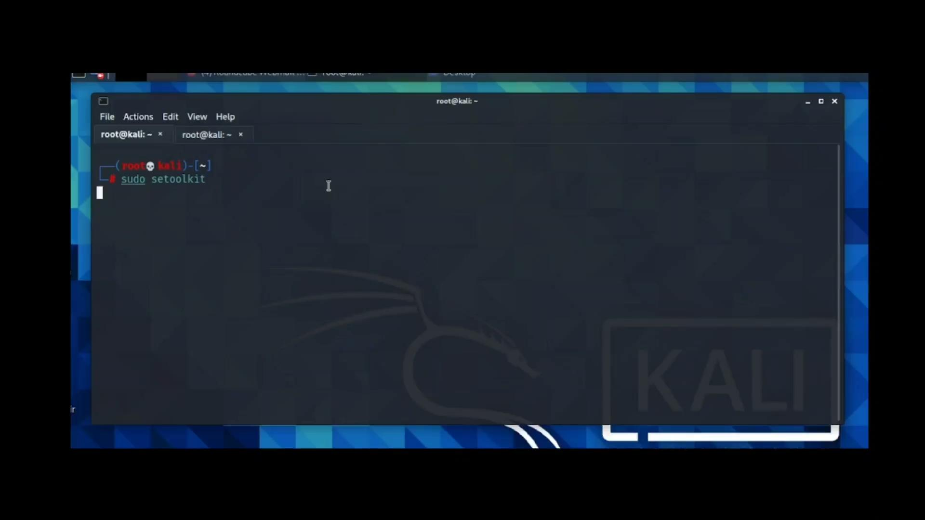
SET: Creating Payload and Listener

Slide 19
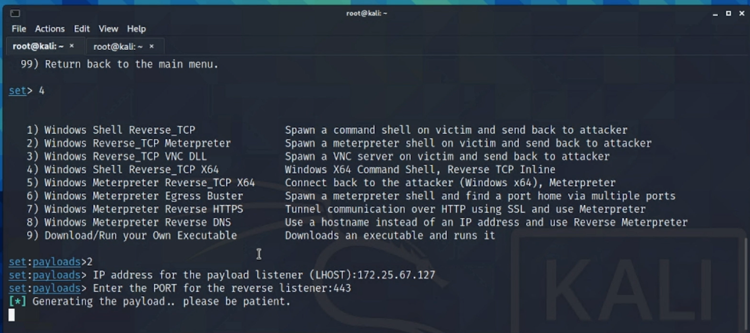
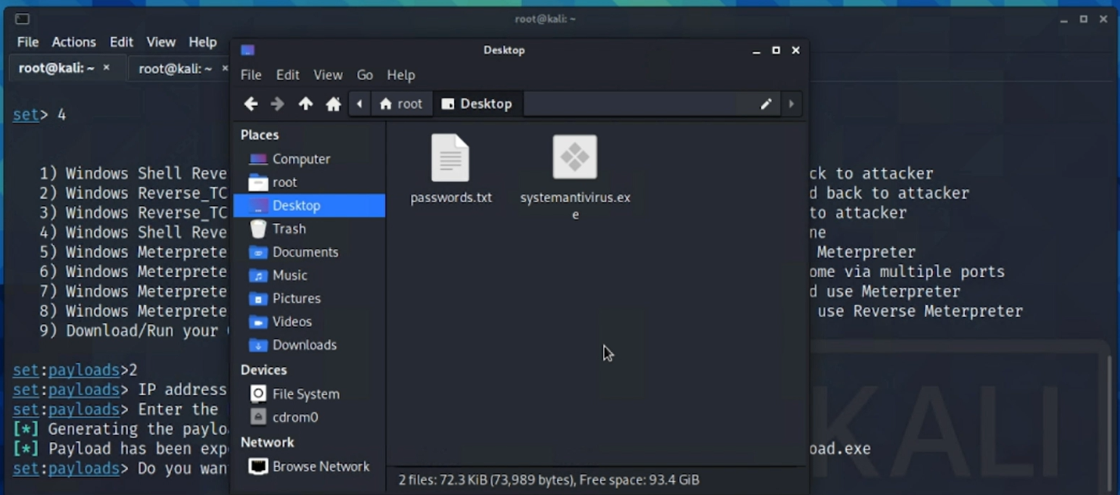
SET: Creating Payload and Listener
Using Windows Reverse_TCP Meterpreter to generate a shell
Renaming the Payload as suited for the phishing attack

Slide 20
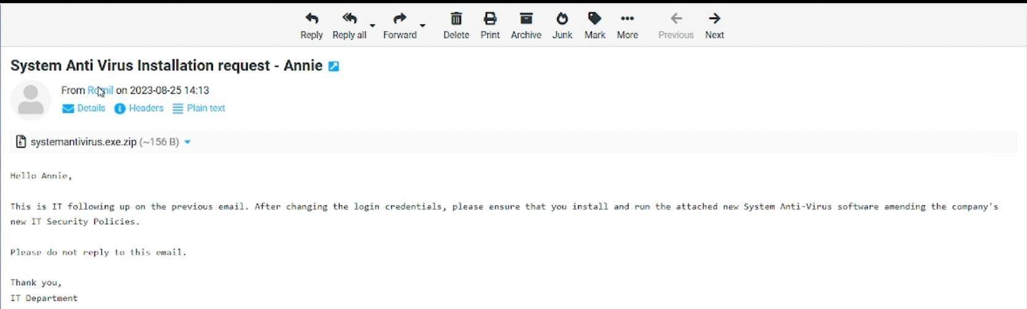
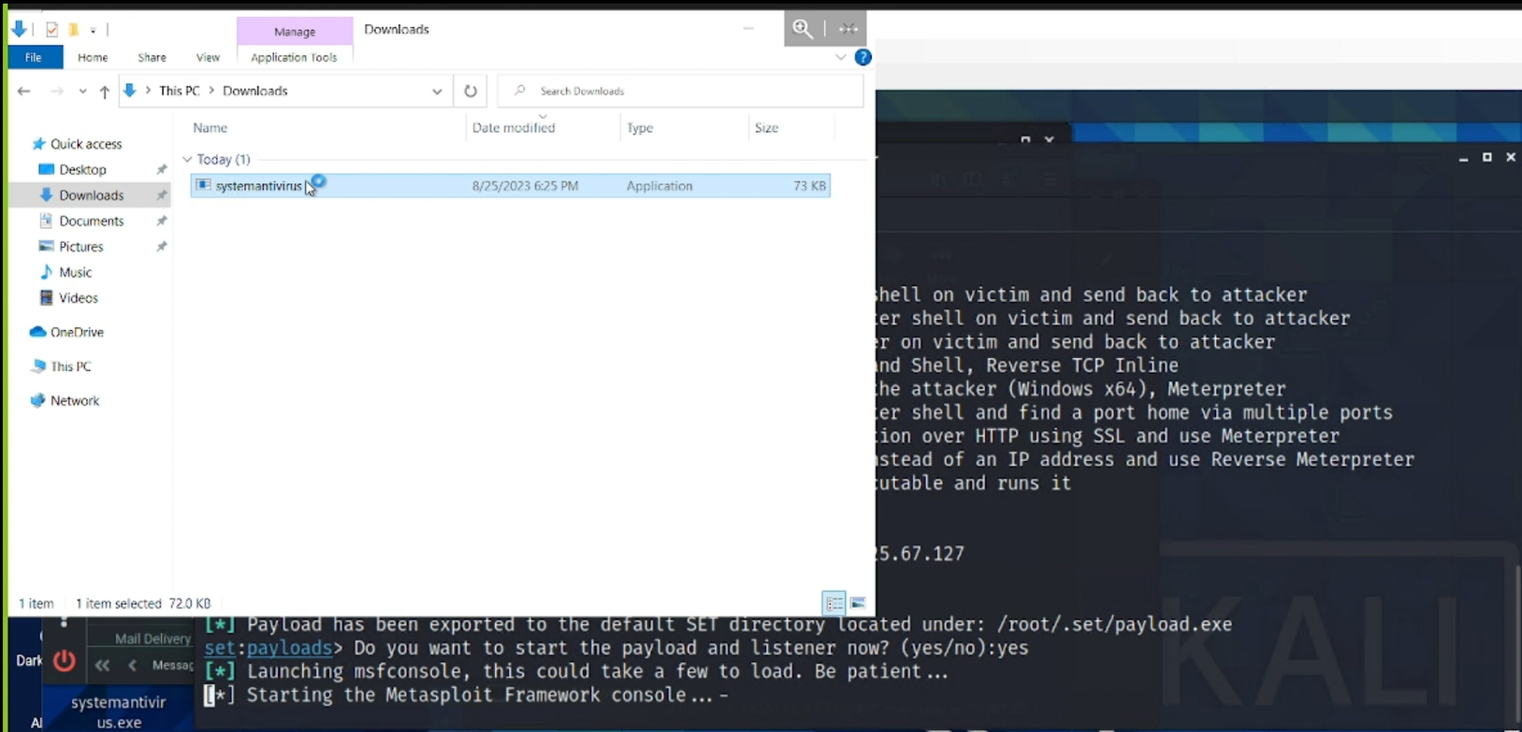
SET: Creating Payload and Listener
Phishing email, carrying the executable payload
Victim falling for the phishing email, downloaded and opened the executable file.

Slide 21
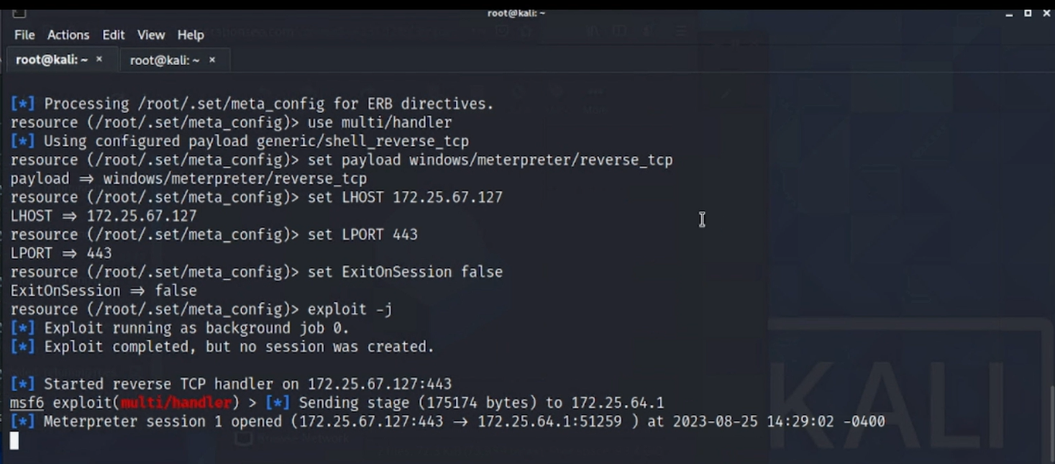
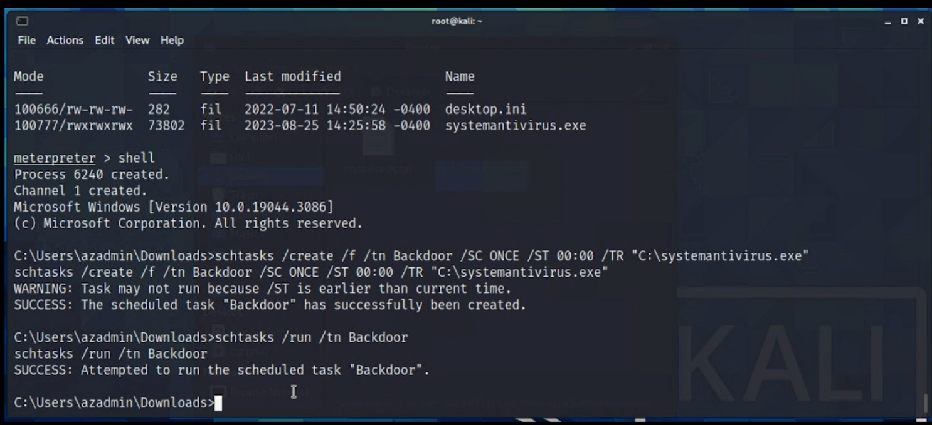
SET: Creating Payload and Listener
As soon as the victim ran the script, the active listener opened a reverse TCP shell connection
Successfully running a scheduled task within the opened session, that would run the payload everyday at midnight, allowing a persistent access to the Victim’s Server.

Slide 22
Web-app Vulnerabilities
What does a vulnerable website look like ?
Why does it matter ?
http://rainbowcrib.com

Slide 23
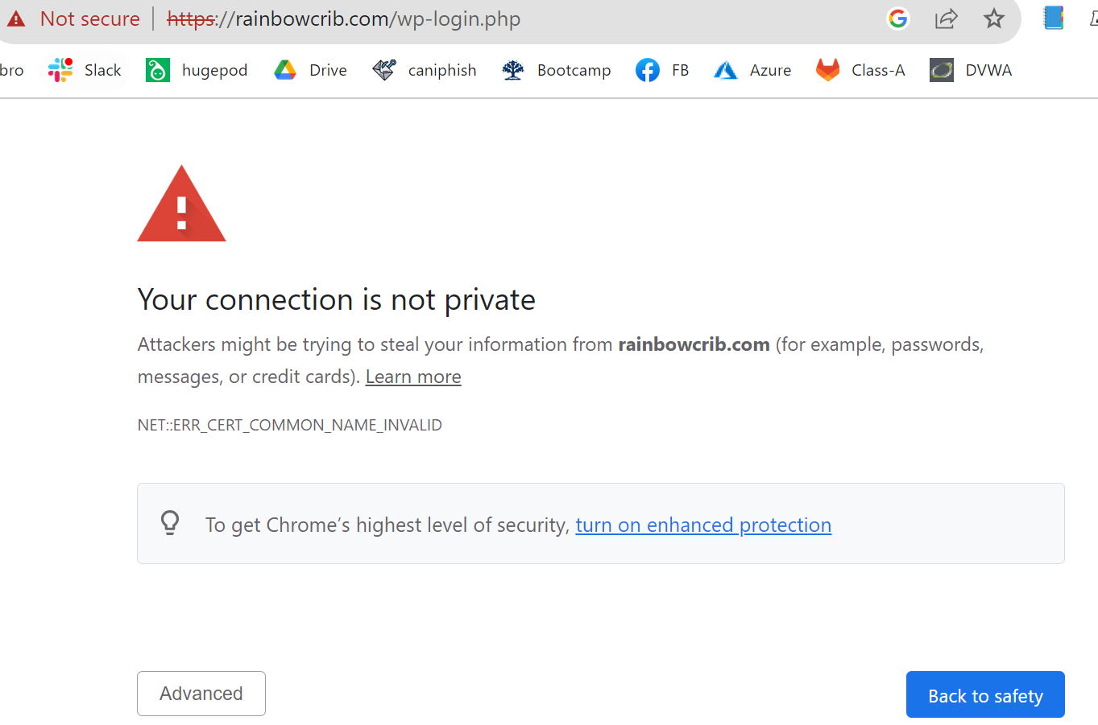
Website vulnerabilities
No SSL Certificate

Slide 24
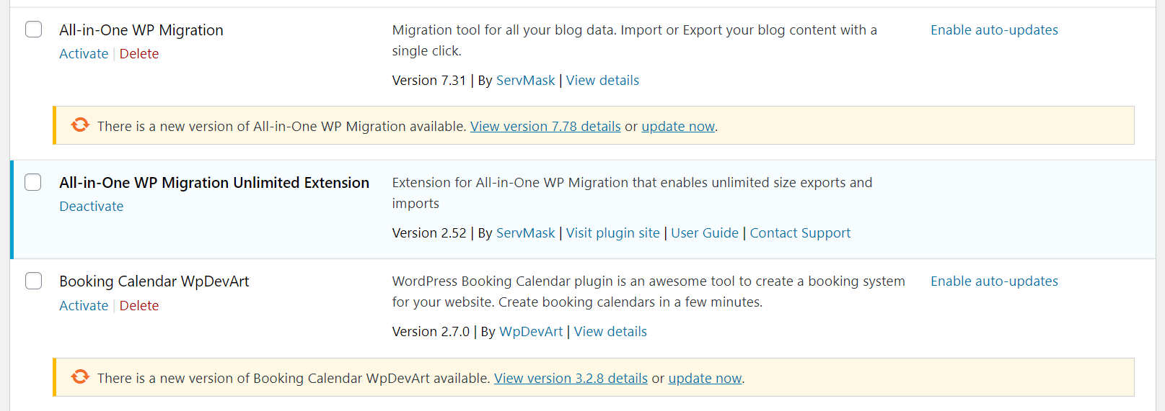
Website vulnerabilities
Outdated Plugins

Slide 25
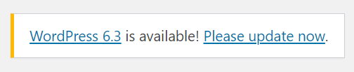
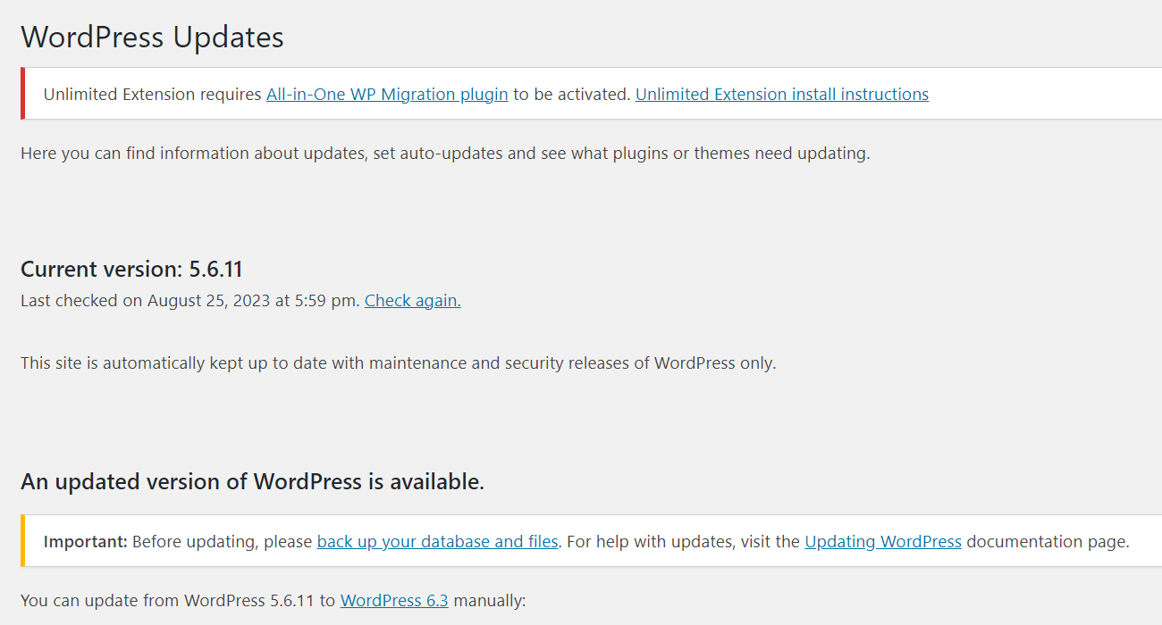
The most notable vulnerabilities in a our website
Outdated Version of Updates
https://rainbowcrib.com/wp-admin/update-core.php

Slide 26
Phishing email analysis steps
Threats or a Sense of Urgency
Grammar and Spelling Errors
Suspicious Attachments
The email domain does not align with the company as stated
Emails Requesting Login Credentials, Payment Information, or Sensitive Data
Scan malicious links using anti virus tools; example: virustotal.com
Notes:
Reference: 5 Simple Tips for Phishing Email Analysis. (n.d.). Fortinet. Retrieved August 26, 2023, from https://www.fortinet.com/resources/cyberglossary/phishing-email-analysis

Slide 27
Mitigation Steps
Credible and updated plugins
Use most current version of WP
Strong passwords
File permissions
Admin privileges
Activity logs
Patch software
Backups
Firewalls
Malware scanning plugins
SSL certificate
Employee Training (Tools such as Caniphish)
Reputable and trusted hosting servers
Website hardening in your wp-config file
Notes:
Reference: https://wpastra.com/resources/why-wordpress-websites-get-hacked/

Slide 28
Thank you!
Any Questions?

